Slide 1
Hierarchical routing
Sunil Lamsal
0217

Slide 2
Contents
Intro to routing
Intro to hierarchical routing

Slide 3
Introduction to Routing
Processing of packets from one network to another network is known as routing
Basic components required to route
Routable Protocol (Ipv4, Ipv6 etc)
Network address with subnet mask
Next hop

Slide 4
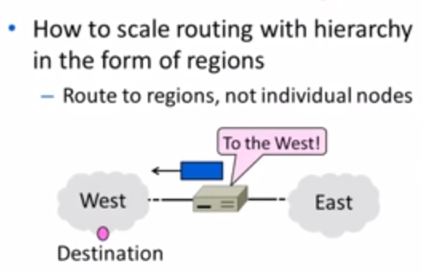

Slide 5
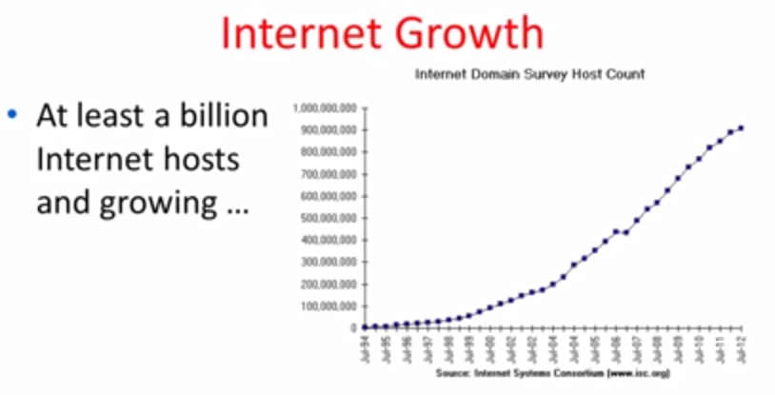

Slide 6
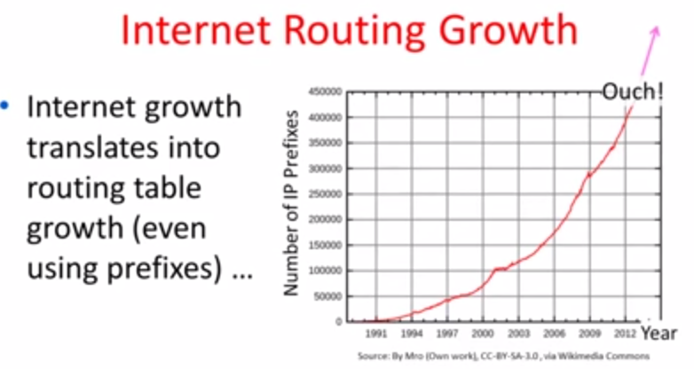

Slide 7
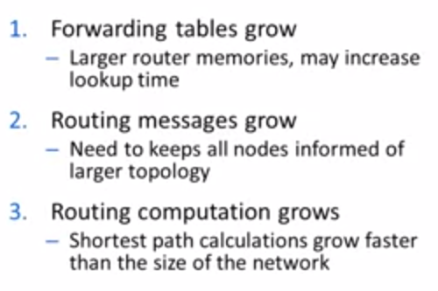
Impact of Routing Growth

Slide 8
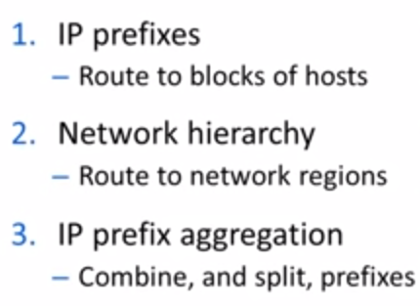
Techniques to Scale Routing

Slide 9
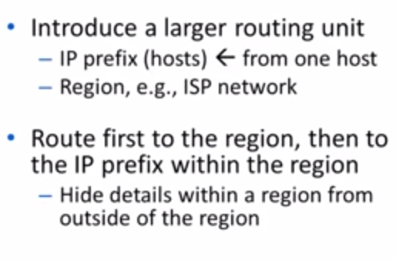
Hierarchical Routing

Slide 10
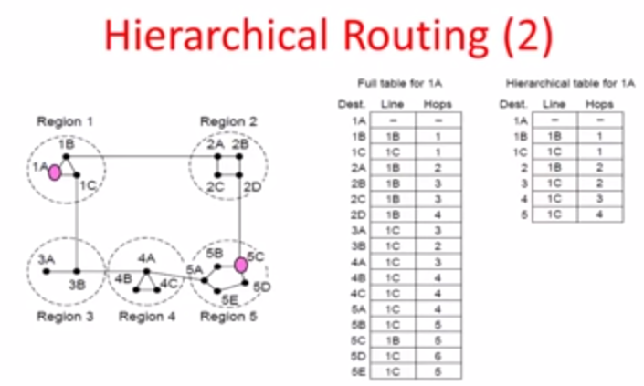

Slide 11
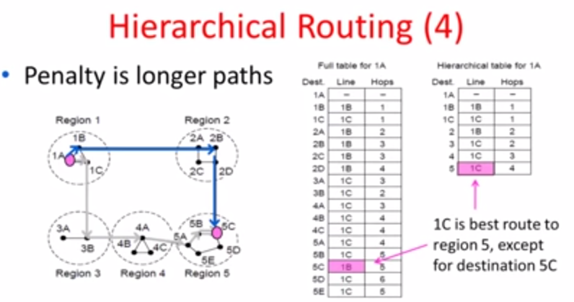

Slide 12
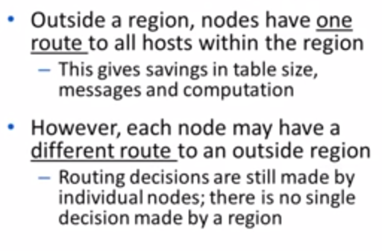

Slide 13
THANK YOU

